Slide 1

LOAN ELIGIBILITY PREDICTION
AND CUSTOMER SEGMENTATION
MICHAEL CANDY - JCDS 08 JKT

Slide 2

Dream Housing Finance company deals in all home loans. They have presence across all urban, semi urban and rural areas.
Customer first apply for home loan after that company validates the customer eligibility for loan.
DATA
https://www.kaggle.com/madhansing/bank-loan2
by Madhan singh

Slide 3

Predict Customer Loan
Eligibility
GOAL
Opportunity for the
Company?

Slide 4

FINTECH
PAYMENT
GATEWAY
DIGITAL
WALLET
LENDING

Slide 5

TYPE OF LOAN

Slide 6
BANK
FINTECH
HOME LOAN
STUDENT LOAN
CAR LOAN
PERSONAL LOAN
P2P LENDING
ONLINE PAYMENT
DIGITAL WALLET
INVESTMENT

Slide 7





DATA CLEANING
DATA ANALYSIS
MODEL BUILDING
CLUSTERING

Slide 8

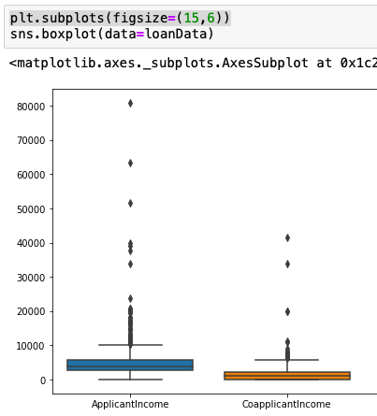
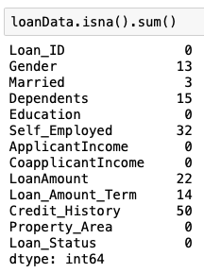
1. LOAN_ID
2. GENDER (MALE/FEMALE)
3. MARRIED (YES/NO)
4. DEPENDENTS (NUMBER OF DEPENDENTS)
5. EDUCATION (GRADUATE / NOT GRADUATE)
6. SELF_EMPLOYED (YES / NO)
7. APPLICANTINCOME
8. COAPPLICANTINCOME
9. LOANAMOUNT
10. LOAN_AMOUNT_TERM
11. CREDIT_HISTORY
12. PROPERTY_AREA
13. LOAN_STATUS (LOAN APPROVED (Y/N))
DATA CLEANING PROCESS
OUTLIERS
NULL VALUES
DATA

Slide 9

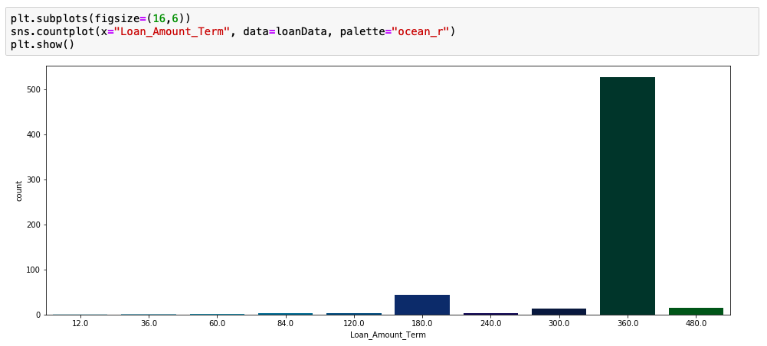
CREDIT HISTORY
DATA ANALYSIS PROCESS
LOAN STATUS
LOAN AMOUNT TERM
DREAM HOUSING FINANCE COMPANY HOME LOANS DATA

Slide 10

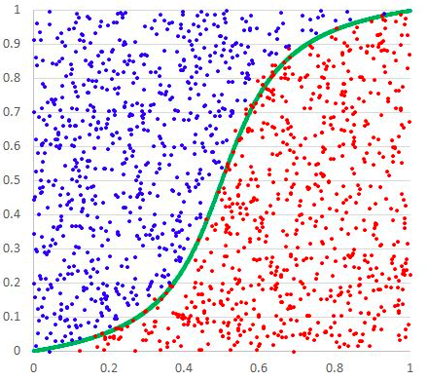
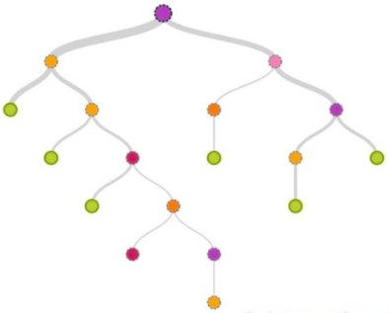
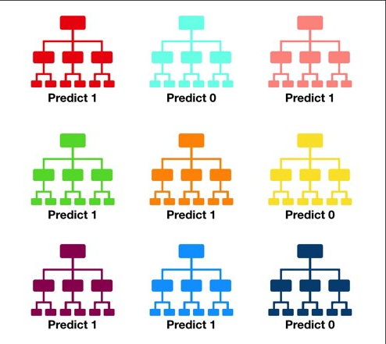
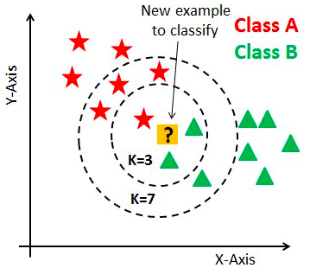
LOGISTIC REGRESSION
DECISION TREE CLASSIFIER
RANDOM FOREST CLASSIFIER
K-NN CLASSIFIER
MODEL BUILDINGS PROCESS
ACURACY SCORE
ACURACY SCORE
ACURACY SCORE
ACURACY SCORE
85.37%
72.36%
82.11%
70.73%

Slide 11

CUSTOMER SEGMENTATION
CLUSTERING
PROCESS
Lower Overall Unit Cost
Better Communication
Increase Profitability
Customer Retention
Focus On The Firm Value
Improves Channel Of Distribution

Slide 12



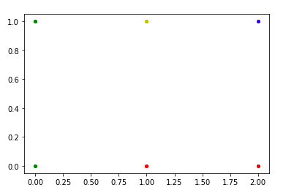
PROPERTY AREA
Car loan
MOST
POTENTIAL
Personal Loan
P2P Lending

Slide 13

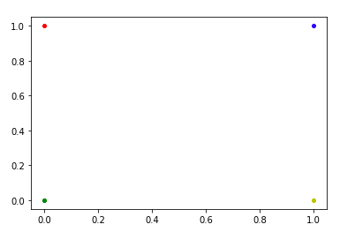
NUMBER OF DEPENDENT
PERSONAL LOAN
STUDENT LOAN
CAR LOAN

Slide 14

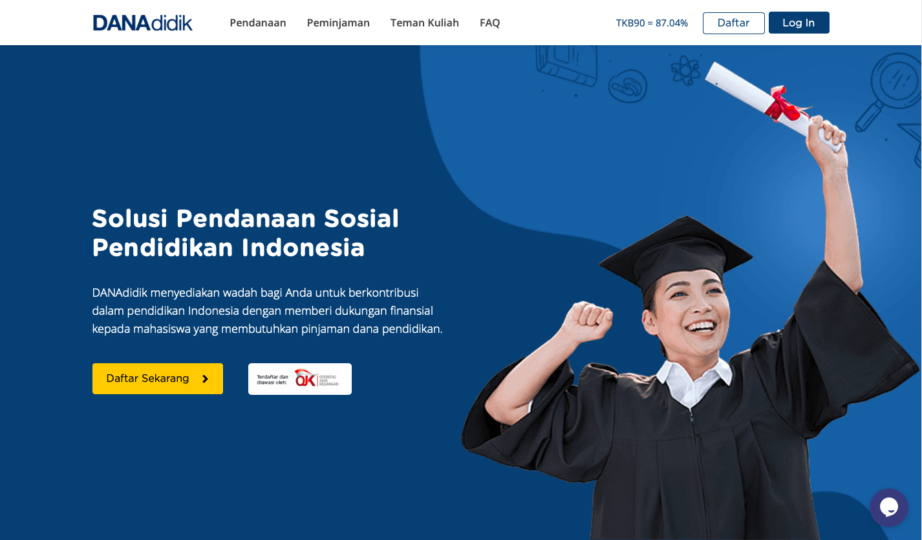
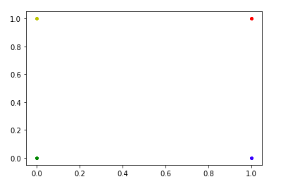
EDUCATIONAL STATUS
MOST
POTENTIAL

Slide 15

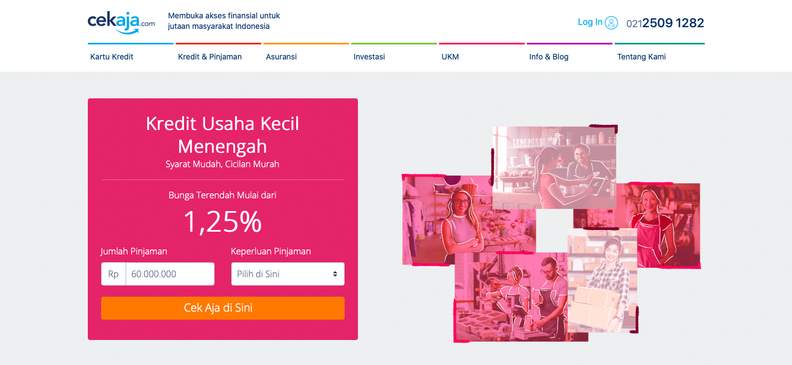
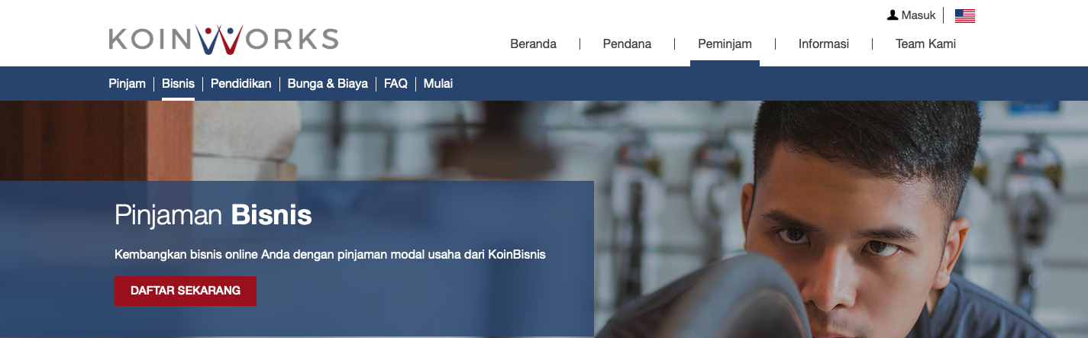
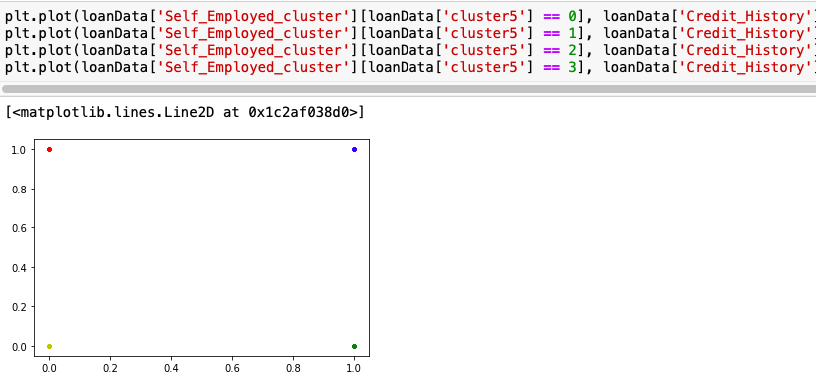
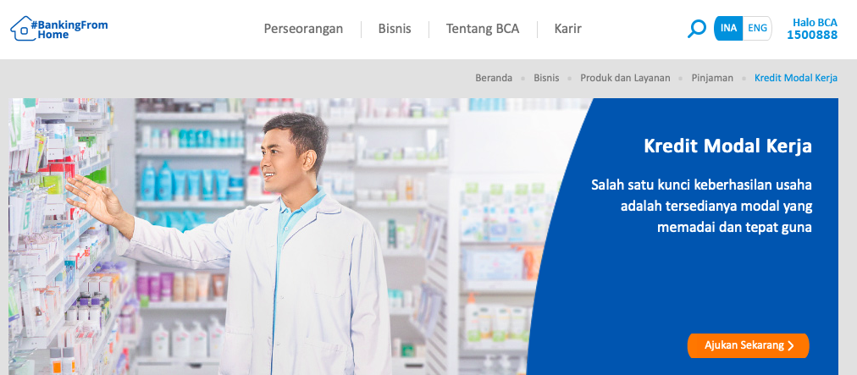
SELF EMPLOYED

Slide 16
THANK YOU
MICHAEL CANDY - JCDS 08 JKT

